Slide 1
Moudle 8 Unit 2
Where's the cat?

Slide 2

yellow
red
blue
green

Slide 3
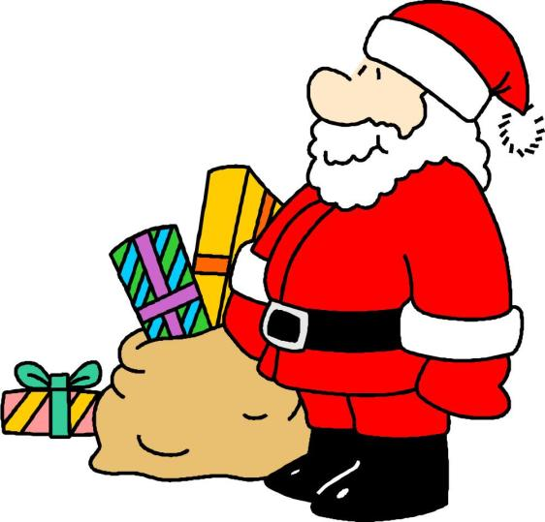

Slide 4



Let's guess！
Is it a …?

Slide 5



Let's guess！
Is it a …?

Slide 6
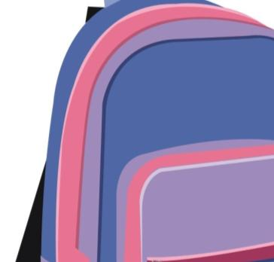


Let's guess！
Is it a …?
Notes:
PPT模板：www.1ppt.com/moban/ PPT素材：www.1ppt.com/sucai/
PPT背景：www.1ppt.com/beijing/ PPT图表：www.1ppt.com/tubiao/
PPT下载：www.1ppt.com/xiazai/ PPT教程： www.1ppt.com/powerpoint/
资料下载：www.1ppt.com/ziliao/ 范文下载：www.1ppt.com/fanwen/
试卷下载：www.1ppt.com/shiti/ 教案下载：www.1ppt.com/jiaoan/
PPT论坛：www.1ppt.cn PPT课件：www.1ppt.com/kejian/
语文课件：www.1ppt.com/kejian/yuwen/ 数学课件：www.1ppt.com/kejian/shuxue/
英语课件：www.1ppt.com/kejian/yingyu/ 美术课件：www.1ppt.com/kejian/meishu/
科学课件：www.1ppt.com/kejian/kexue/ 物理课件：www.1ppt.com/kejian/wuli/
化学课件：www.1ppt.com/kejian/huaxue/ 生物课件：www.1ppt.com/kejian/shengwu/
地理课件：www.1ppt.com/kejian/dili/ 历史课件：www.1ppt.com/kejian/lishi/

Slide 7



Let's guess！
Is it a …?

Slide 8



Let's guess！
Is it a …?

Slide 9


Let's guess！
Is it a …?

Slide 10

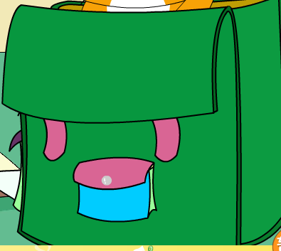

Slide 11
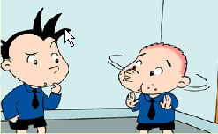

Moudle 8 Unit 2
Where's the cat?

Slide 12
Listen、answer and circle!
1、What are Daming and Sam looking for?
(大明和萨姆正在找什么？)
2、Circle "Where's the … ?"

Slide 13




Slide 14
Listen read and answer!
1、How many bags?
2、What colour ?

Slide 15



the yellow bag
the green bag
the blue bag

Slide 16




Where's the cat?
the yellow bag
the green bag
the blue bag
Is it in…？
Yes,it is/No,it isn't

Slide 17
Where's the bird?
the yellow bag
the green bag
the blue bag
It‘s in…

Slide 18
SHOW TIME
 | Bab for the cartoon （小组成员选择角色为动画配音）
 | Act it out. (角色表演，可以拿英语书)
 | Act it out. (选择你喜欢的情节进行表演，不拿书。）

Slide 19




Ask and answer

Slide 21


the yellow bag
the green bag
the blue bag

Slide 22
HOMEWORK
1、Read the passage for your parents.
2、选择你喜欢的情节进行背诵并试着表演。

